Slide 1
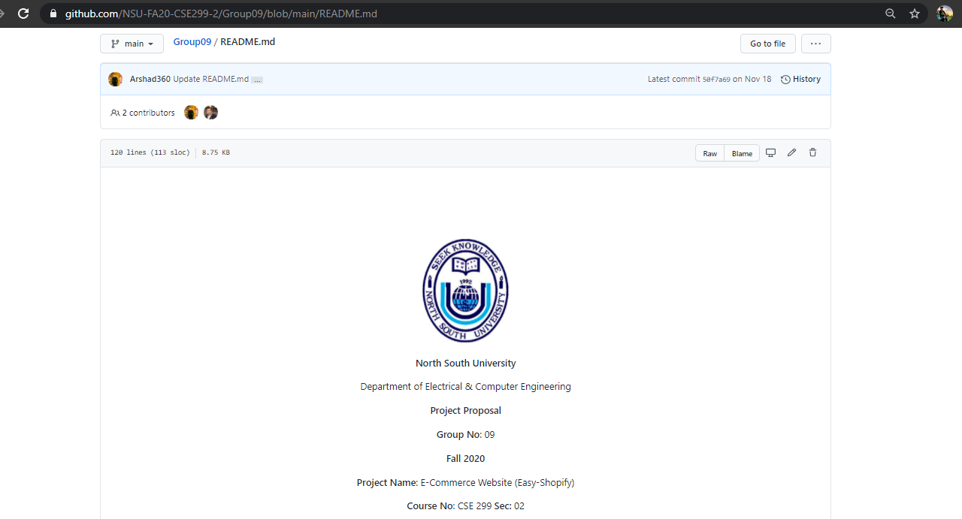
Project Readme

Slide 2
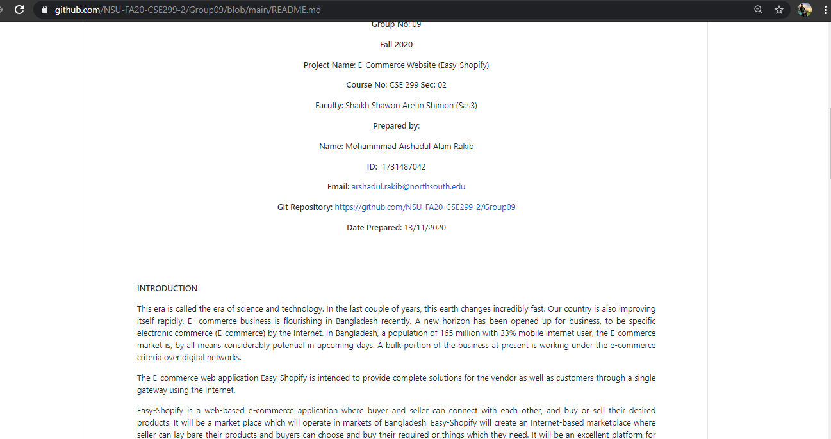
Project Readme (Continue)

Slide 3
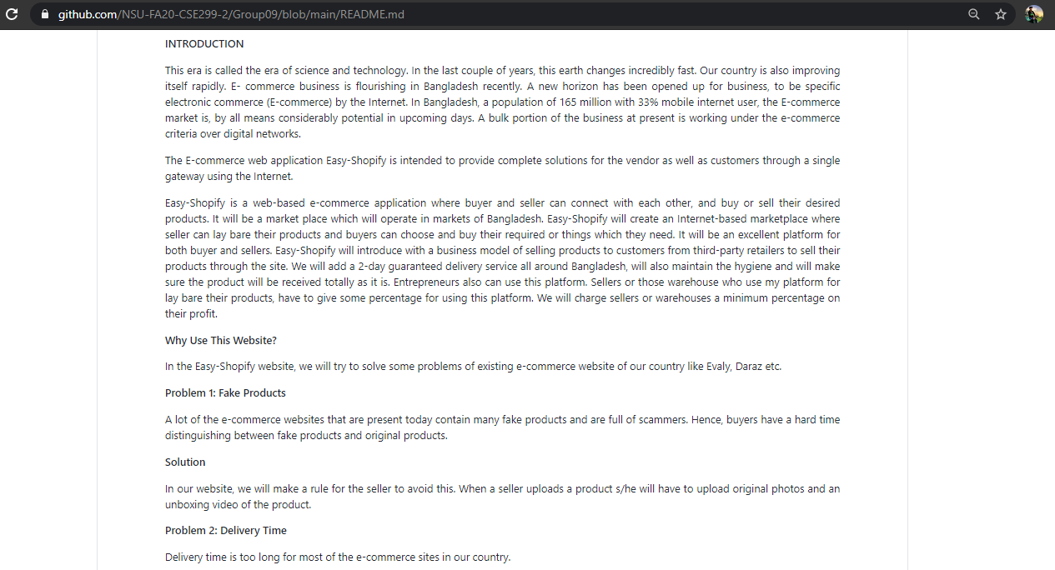
Project Readme (Continue)

Slide 4
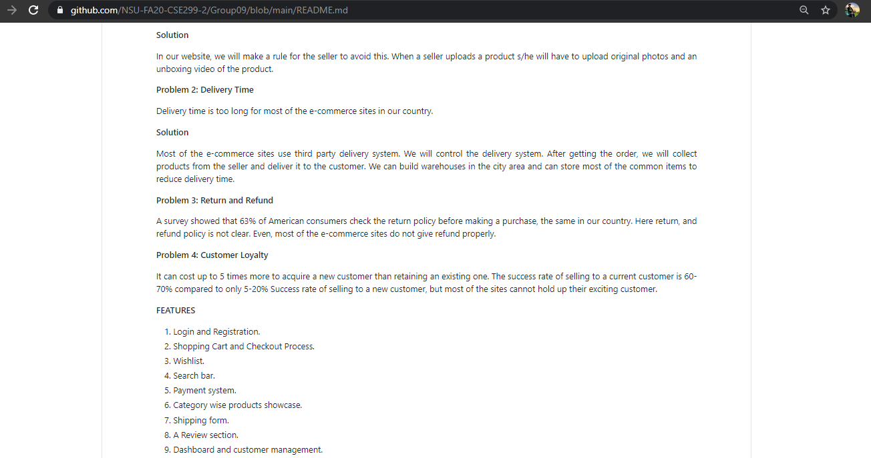
Project Readme (Continue)

Slide 5
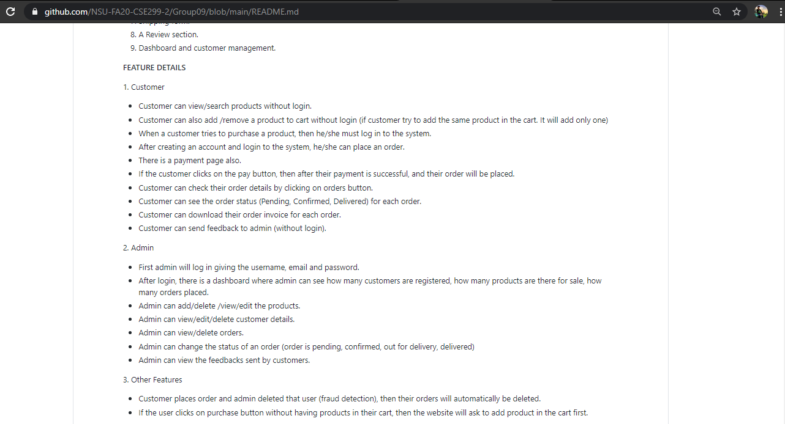
Project Readme (Continue)

Slide 6
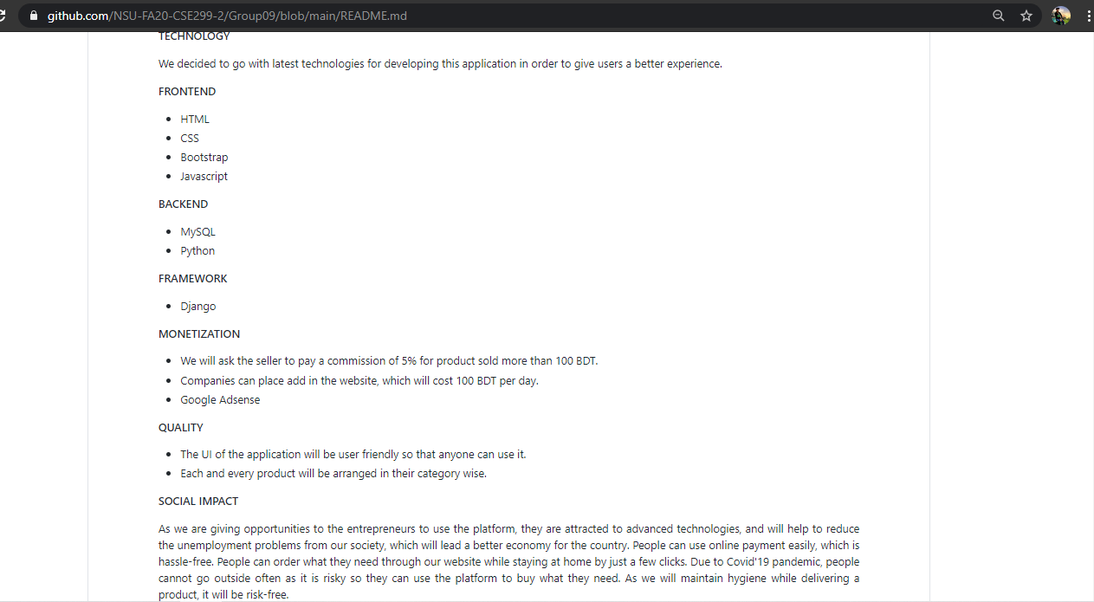
Project Readme (Continue)

Slide 7
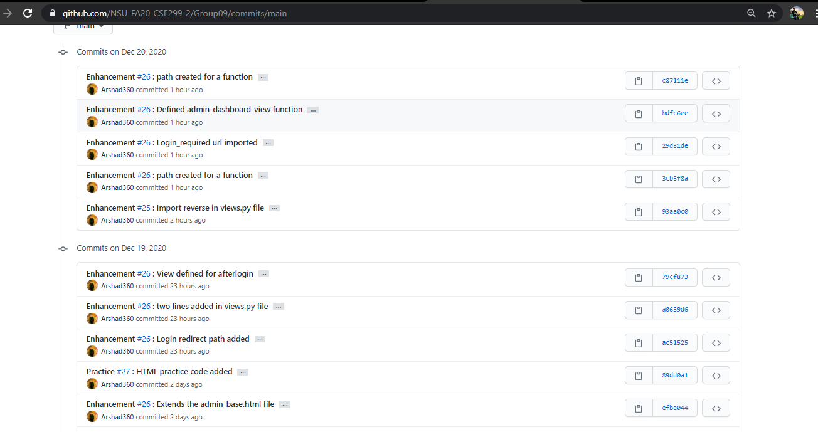
Commits

Slide 8
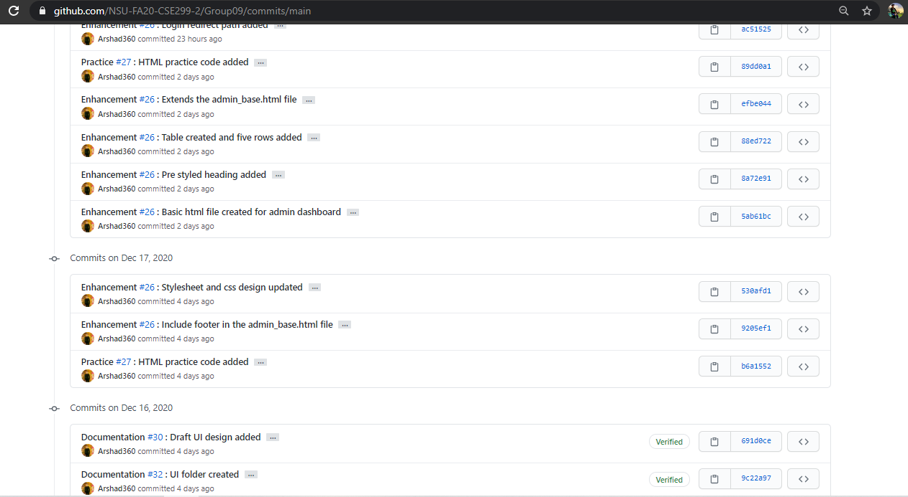
Commits (continue)

Slide 9
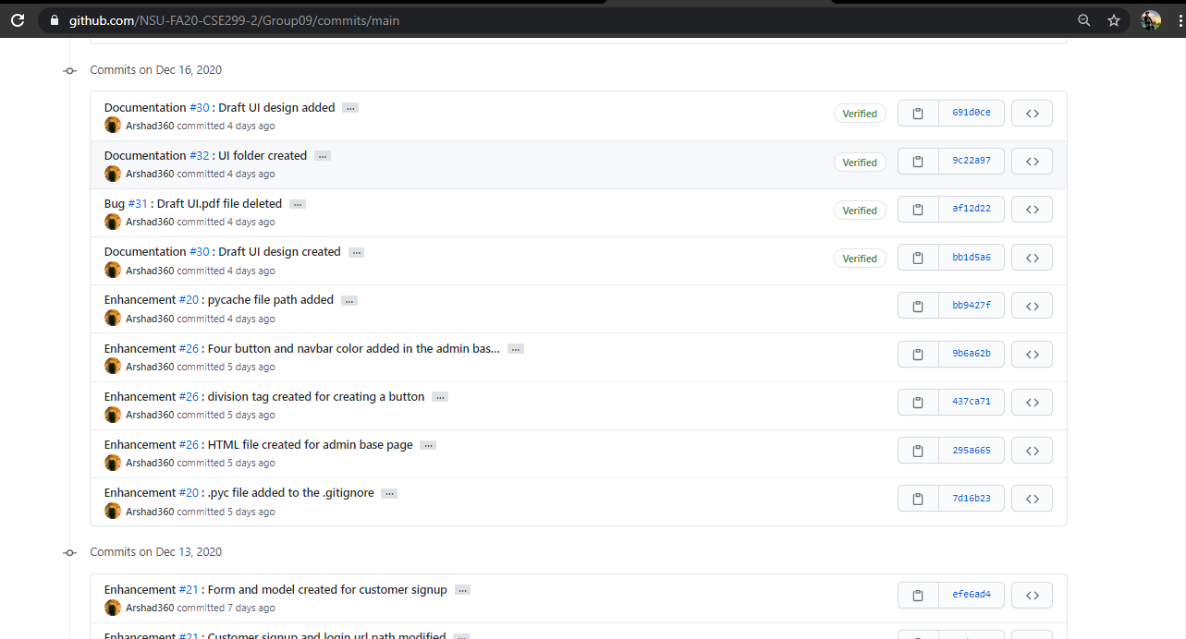
Commits (continue)

Slide 10
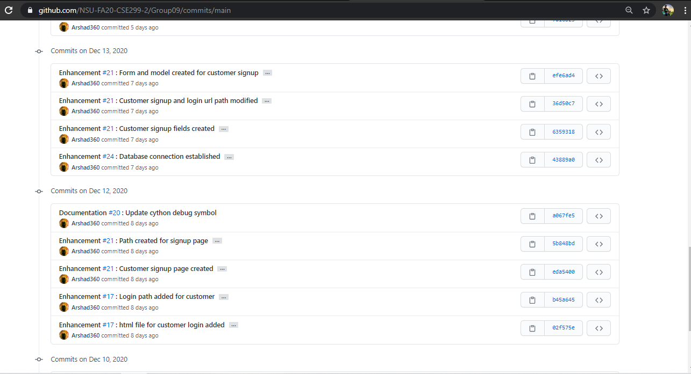
Commits (continue)

Slide 11
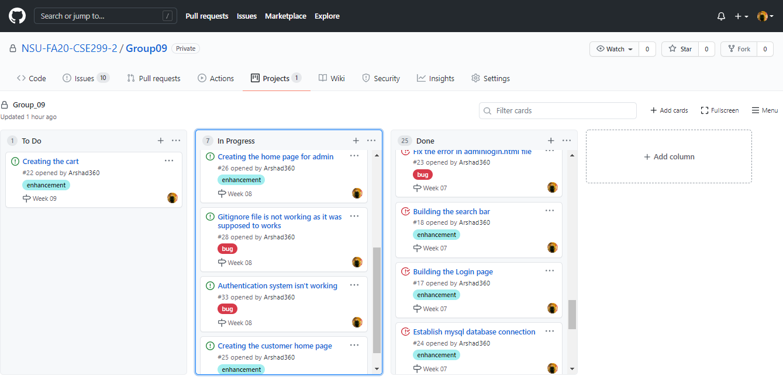
Issue board

Slide 12
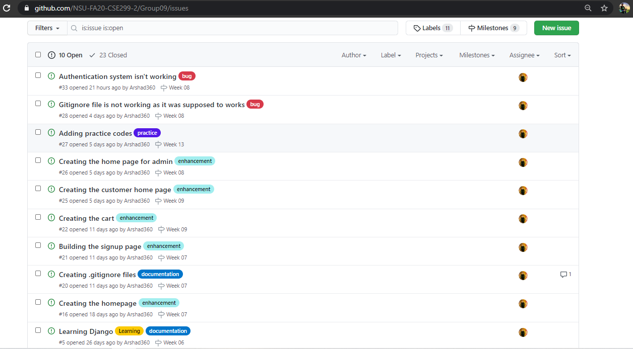
Issues (Open)

Slide 13
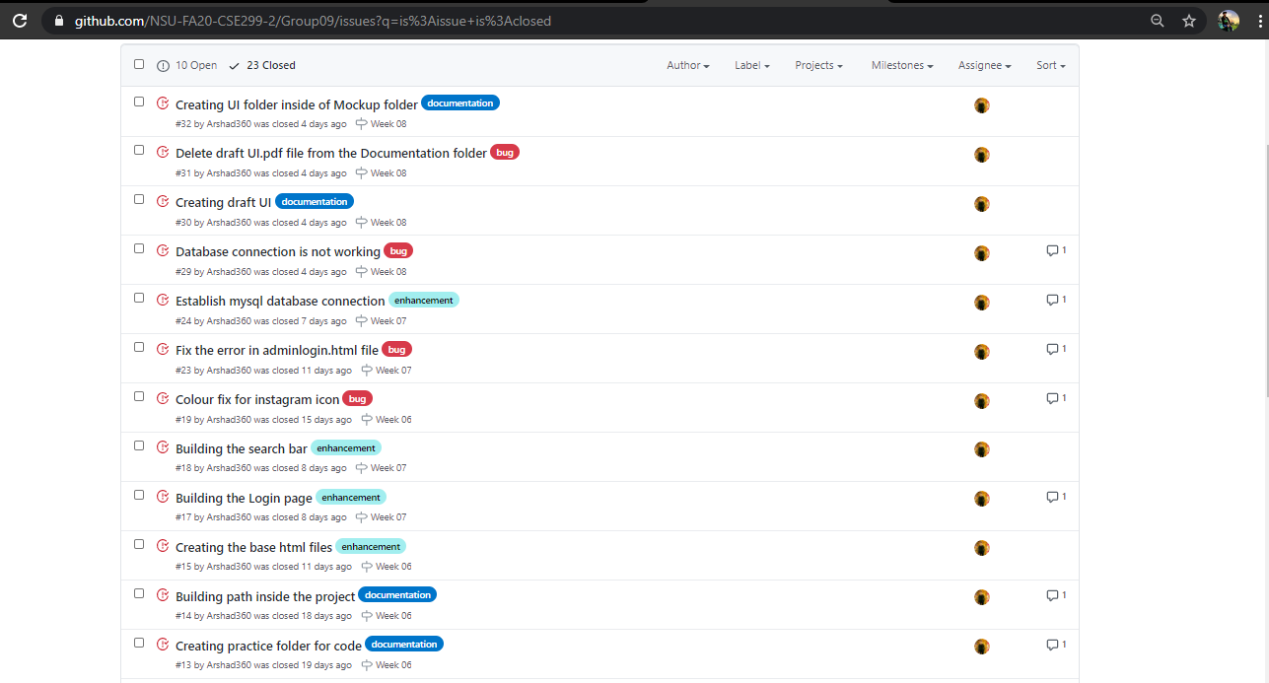
Issues (Closed)

Slide 14
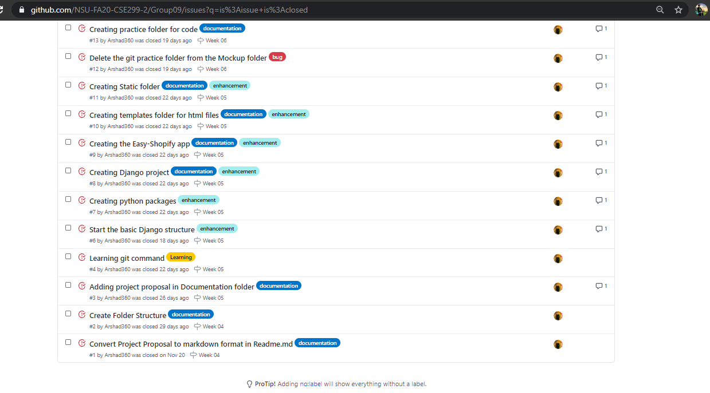
Issues (Closed)

Slide 15
The END!

